Slide 1
Software Engineering
Unit-1 Software Engineering Fundamentals

Slide 2
Definition of Software
Software is a set of instructions, programs, and data that tells a computer what to do, while software engineering is the disciplined process of designing, developing, testing, and maintaining these systems
Software is a program or set of programs containing instructions that provide the desired functionality. Engineering is the process of designing and building something that serves a particular purpose and finds a cost-effective solution to problems.
It is a systematic disciplined, cost effective techniques for software development engineering approach to develop a software.

Slide 3
The evolving role of software
Dual Role of Software:
There is a dual role of software in the industry. The first one is as a product and the other one is as a vehicle for delivering the product.
As a Product
As a Vehicle for Delivering a Product

Slide 4
The evolving role of software
1. As a Product
It delivers computing potential across networks of Hardware.
It enables the Hardware to deliver the expected functionality.
It acts as an information transformer because it produces, manages, acquires, modifies, displays, or transmits information.
2. As a Vehicle for Delivering a Product
It provides system functionality (e.g., payroll system).
It controls other software (e.g., an operating system).
It helps build other software (e.g., software tools).

Slide 5
Changing nature of software
System software:
Collection of progrms written to provide service for other progrmas
Ex.compilers, file management
2. Application Software:
designed to help users to perform specific task
Ex. C, Java
3. Engineering and Scientific Software:
for complicated numeric calculations
Ex. Statistics

Slide 6
Changing nature of software
4. Embedded Software:
It lies in hardware of system and used for control functions.
Ex. Microwave oven controls
5. Product Line Software:
It provides specific capabilities for SE
Ex. Computer Graphics , DBMS
6. Web Application Software:
These are used over a network
Ex. Websites
7. Artificial Intellignece Software:
Non-numeric algorithms to solve complex problems
Ex. Robotics, Gaming

Slide 7
Software myths
Software myths are misconceptions or false beliefs about various aspects of software development, including management, engineering processes, and end-user expectations.
They can affect different stakeholders, such as clients, managers, and developers, leading to unrealistic expectations, poor decision-making, and inefficient workflows.
Management Myths :
Myth 1: We already have a book that’s full of standards and procedures for building software.
Myth 2: If we get behind schedule, we can add more programmers and catch up
REALITY: Software development is not a mechanical process like manufacturing; adding people to a late software project makes it later.

Slide 8
Software myths
Myth 3: If I decide to outsource the software project to a third party, I can just relax and let that firm build it.
REALITY: If an organization does not understand how to manage and control software projects internally, it will invariably struggle when it outsources software projects.
2. Customers Myths :
Myth 1: A general statement of objectives is sufficient to begin writing programs — we can fill in the details later.
Reality: A poor up-front definition is the major cause of failed software efforts. A formal and detailed description of the information domain, function, behavior, performance, interfaces, design constraints, and validation criteria is essential. These characteristics can be determined only after thorough communication between customer and developer.

Slide 9
Software Process
Myth 2: Project requirements continually change, but change can be easily accommodated because software is flexible.
Reality: It is true that software requirements change, but the impact of change varies with the time at which it is introduced.
3. Practitioner’s Myths :
Myth 1: Once we write the program and get it to work, our job is done.
Reality: Someone once said that “the sooner you begin ‘writing code’, the longer it’ll take you to get done.” Industry data indicate that between 60 and 80 percent of all effort expended on software will be expended after it is delivered to the customer for the first time.

Slide 10
Software Process
Myth 2: Until I get the program “running”, I have no way of assessing its quality.
Reality: One of the most effective software quality assurance mechanisms can be applied from the inception of a project — the formal technical review. Software reviews are a “quality filter” that have been found to be more effective than testing for finding certain classes of software defects.
Myth 3: The only deliverable work product for a successful project is the working program.
Reality : A working program is only one part of a software configuration that includes many elements. Documentation provides a foundation for successful engineering and, more important, guidance for software support.

Slide 11
The Process Framework
Process framework plays a major role in every software development activity as it forms a base in initiating the development process. It is used to estimate certain framework activities which are applied in very developmental activity, irrespective of its size. The process framework includes several umbrella activities, which are useful throughout the software development process
Activity : Activities are groups of related tasks and actions for a major objective.
Action : It is a set of tasks that produce a major work product.
Task: They focus on a small, specific objective.

Slide 12
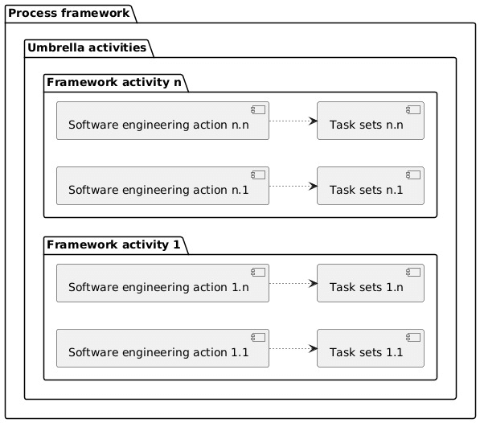
The Process Framework

Slide 13
The Process Framework
1. Communication
This refers to a framework activity where, usually the end users (say customers) are communicated and their views related to the project are analyzed. Here, reports related to customer requirement specifications are developed.
2. Planning
In this framework activity, usually the entire work schedule which is going to be implemented in further stages is prepared. Hence, various issues to be addressed during this framework are risks, requirement of resources, software schedules, important products to be developed etc.

Slide 14
The Process Framework
3. Modelling
Once the developer is done with analyzing the customer requirement specifications, the third framework activity will be modeling. Here, usually UML diagrams are used to represent the project in the form of architecture. This helps developers and the customer to gain an insight of the end product.
4. Construction
It is a combination of code generation and testing.
5. Deployment
In this framework activity, usually the developed project is delivered to the end users. They deploy the project and give relative feedbacks to the developers.

Slide 15
Umbrella Activities
There are eight umbrella activities of a software process framework. They are:
Tracking and controlling software project
Managing risks
Software Quality Assurance (SQA)
Formal technical reviews
Software measurements
Software Configuration Management (SCM)
Managing reusability factor
Preparing and producing software work products

Slide 16
Umbrella Activities
1. Tracking and controlling software project
The first umbrella activity is tracking and controlling the software project. This activity allows the software team to perform the following tasks:
Assessing of progress of the project against the plan of the project
Maintaining the schedule of the project by taking appropriate action based on above assessment
2. Managing risks
Evaluation of those risks that can have a serious impact on the final result of the project
Assessment of those risks that are likely to affect the product’s quality

Slide 17
Umbrella Activities
3. Software Quality Assurance (SQA)
This activity ensures the software quality by defining and organizing the activities needed to assure quality of software.
4. Formal technical reviews
This activity tries to eliminate errors as quickly as possible so that they don’t affect the other activities. It is done by evaluation of work products of software engineering.
5. Software measurements
This activity describes as well as gathers measures of process, product, and project through which software team can deliver a software that fulfills the needs of the customer.

Slide 18
Umbrella Activities
6. Software Configuration Management (SCM)
SCM is also referred to as Change Management (CM). During the software engineering process, SCM defines a set of activities for managing the changes made to the software components.
7. Managing reusability factor
It defines the basic criteria for reusing a work product. Other than this, it also defines a criteria for software components reuse.
It also obtains reusable components by developing the desired methods

Slide 19
Umbrella Activities
8. Preparing and producing software work products
The last and final activity is the preparation and production of work products. It includes certain activities that are needed for the creation of the following work products:
Models
Logs
Documents
Lists and forms

Slide 20
Process Adaptation
Process adaptation refers to the ability of a process to change or adjust itself in response to changes in its environment or context. This concept is commonly used in fields such as business process management, software engineering, and manufacturing.
Definition: Process adaptation is the modification of a process's behavior or structure to better suit new conditions or requirements.
Purpose: To maintain or improve the effectiveness and efficiency of the process when external or internal factors change.

